Slide 1
Live oil – surfactant phase behavior
Aparna Sagi, Maura Puerto,
Clarence Miller, George Hirasaki
April 23, 2012

Slide 2
Introduction
Surfactants → ultra low IFT → EOR
Optimal salinity (ultra-low IFT) for a surfactant system dependent on
  Oil composition: dead vs live oil
  Temperature, pressure, WOR, etc
Objective:
  Determine and compare surfactant optimal salinity for dead and live crude oil (CO₂, CH₄,C₂H₆)

Slide 3
System description
Temperature: 30ºC
Surfactant: S13D/S2 (90/10 wt.) 1wt% (aq.)
  S13D: iC₁₃ -13PO sulfate
  S2: C₁₅₋₁₈ internal olefin sulfonate
Brine: 11,000ppm (incl. Ca²⁺, Mg²⁺) – TB2
Crude oil: 28º API (dead) with
  No dissolved gas (dead oil)
  Methane @ 600psi
  Ethane @ 50psi, 95psi
  Carbon dioxide @ 60psi, 600psi

Slide 4
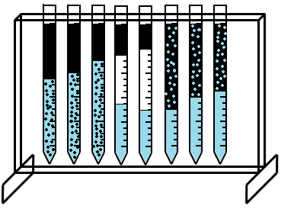
Experimental procedure – dead oil
Seal open end
24 hr
Oil
Initial interface
Brine + surfactant
Pipette
(bottom sealed)
Varying salinity
micro
micro
Winsor Type - I
Winsor Type - III
Winsor Type - II
Optimal salinity

Slide 5

Experimental procedure – live oil
Purge cell of air
Make live oil
Inject surf. solution
Gas
P
Gas
P
P
Oil
Surf.
soln.
Observe phases
Hand mix sample
Inc. temp. to 30°C
P
P

Slide 6
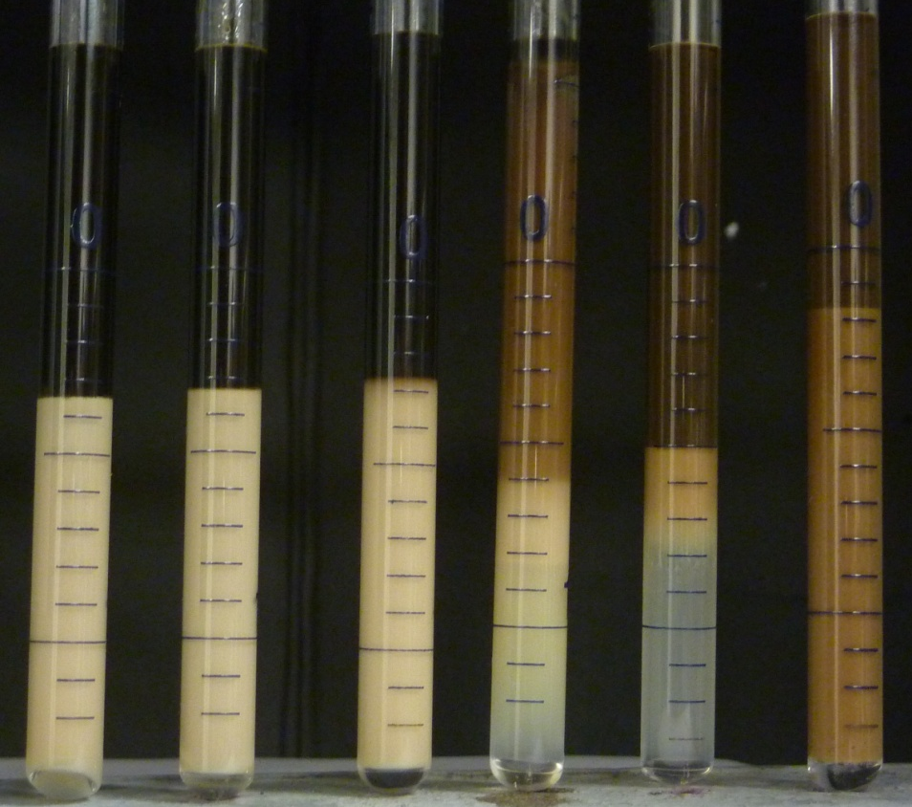
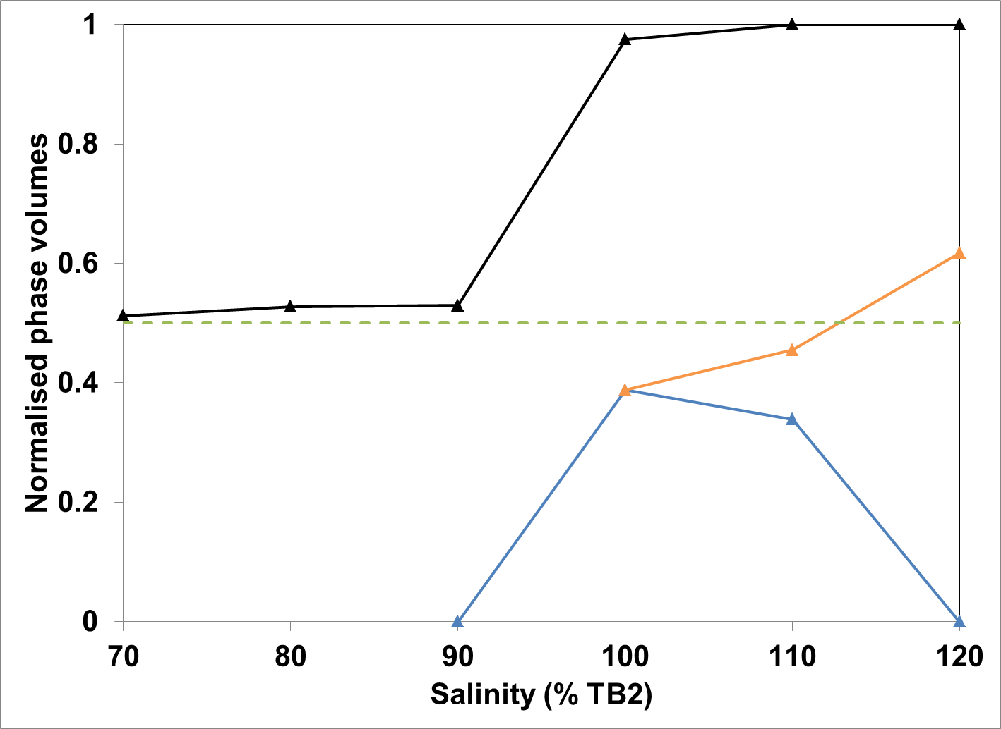
Results – dead oil
Salinity (% TB2)
70% 80% 90% 100% 110% 120%
OIL
V_{o}/V_{s} ~ 6
Optimal
Initial w/o interface
MACRO EMULSION
MICRO EMULSION
WATER
Type I
Type I
Type I
Type II
Type II
Type II

Slide 7
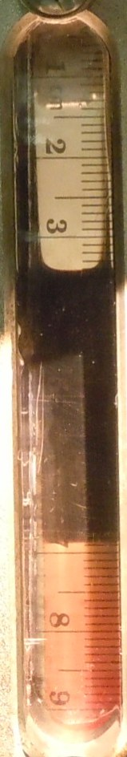
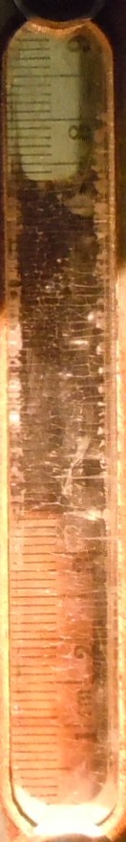
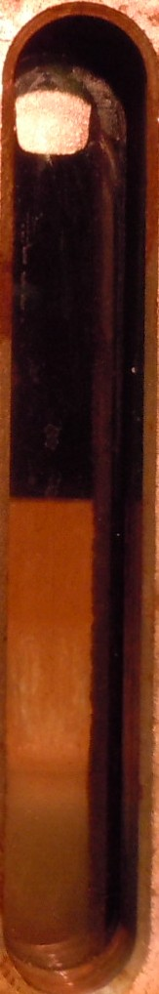
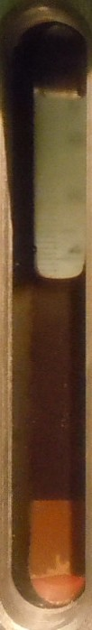
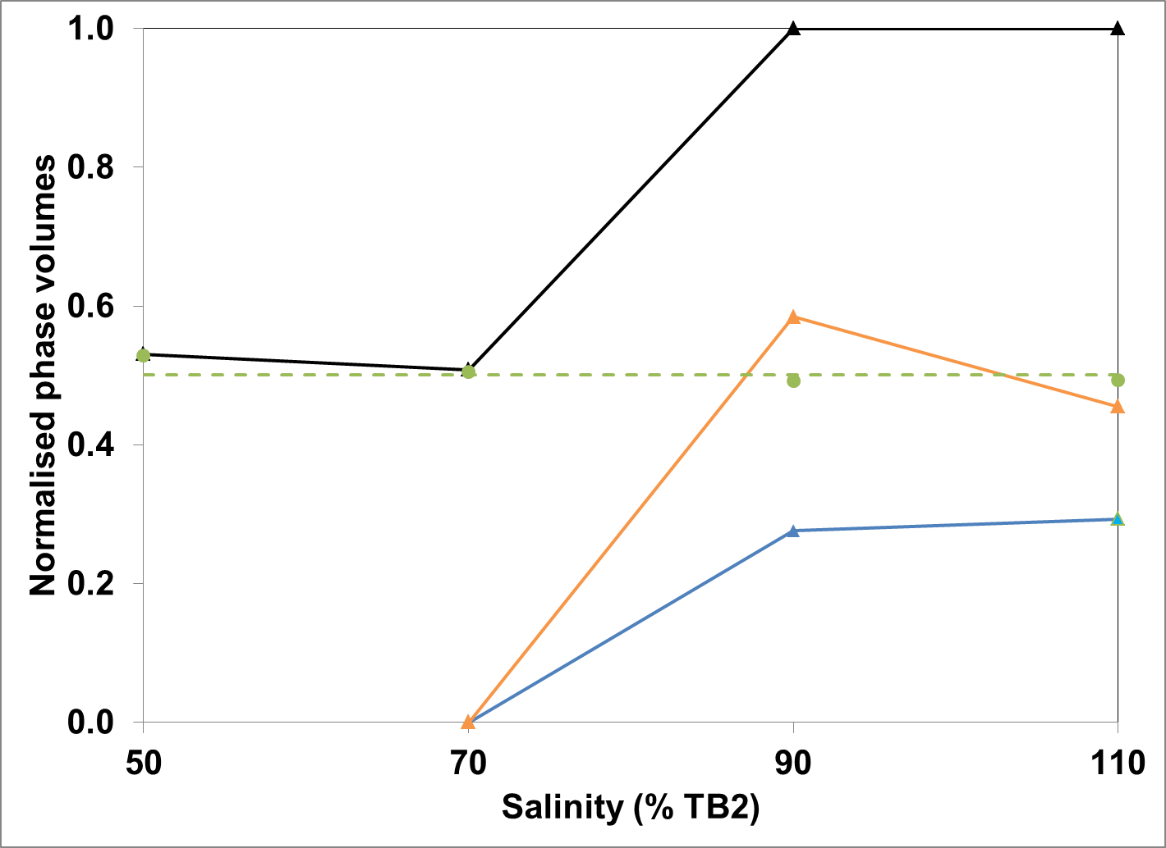
Results – Methane @ 600psi
Salinity (% TB2)
50% 70% 90% 110%
OIL
Optimal
Initial w/o interface
MACRO EMULSION
MICRO EMULSION
WATER
Type I
Type I
Type II
Type II

Slide 8
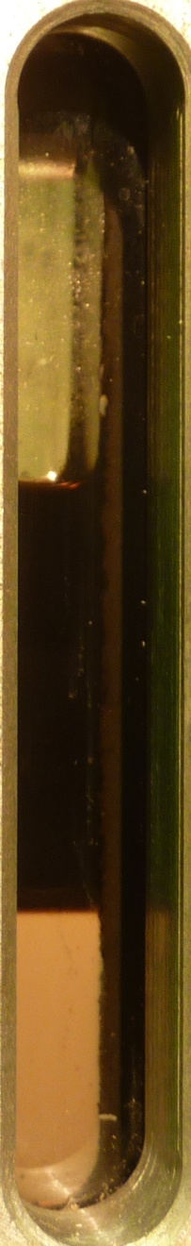
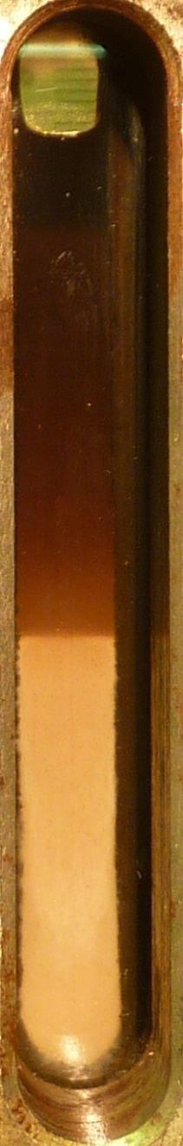
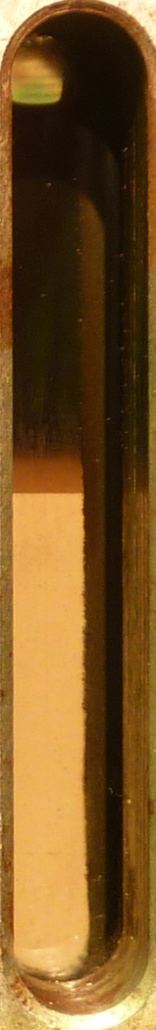
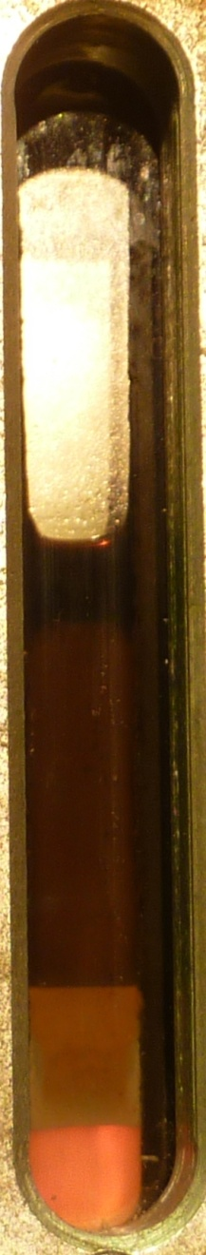
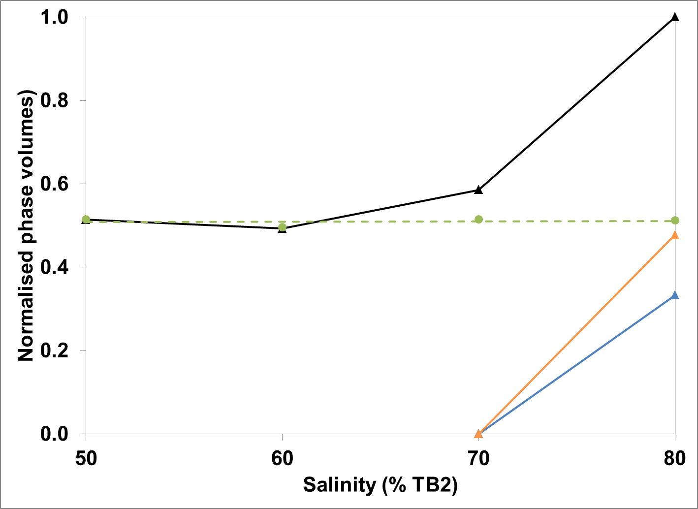
Results – Ethane @ 50psi
Salinity (% TB2)
50% 60% 70% 80%
V_{o}/V_{s} ~ 13
Optimal
OIL/ OIL+MACRO
Initial w/o interface
MACRO
MICRO EMULSION
WATER
Type I
Type I
Type I
Type II

Slide 9
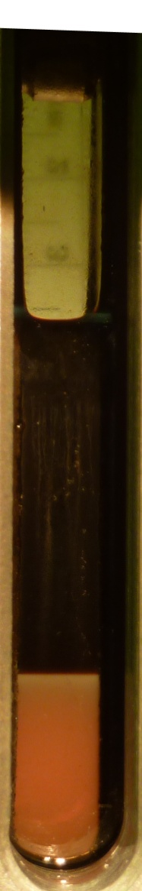
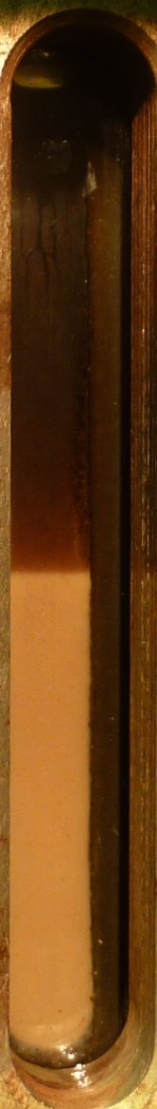
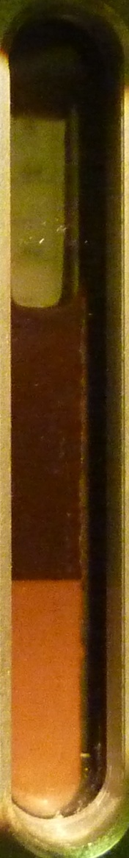
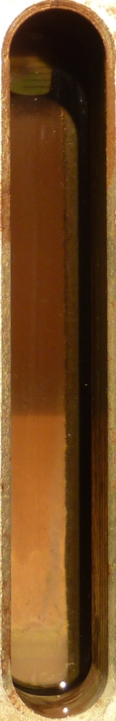
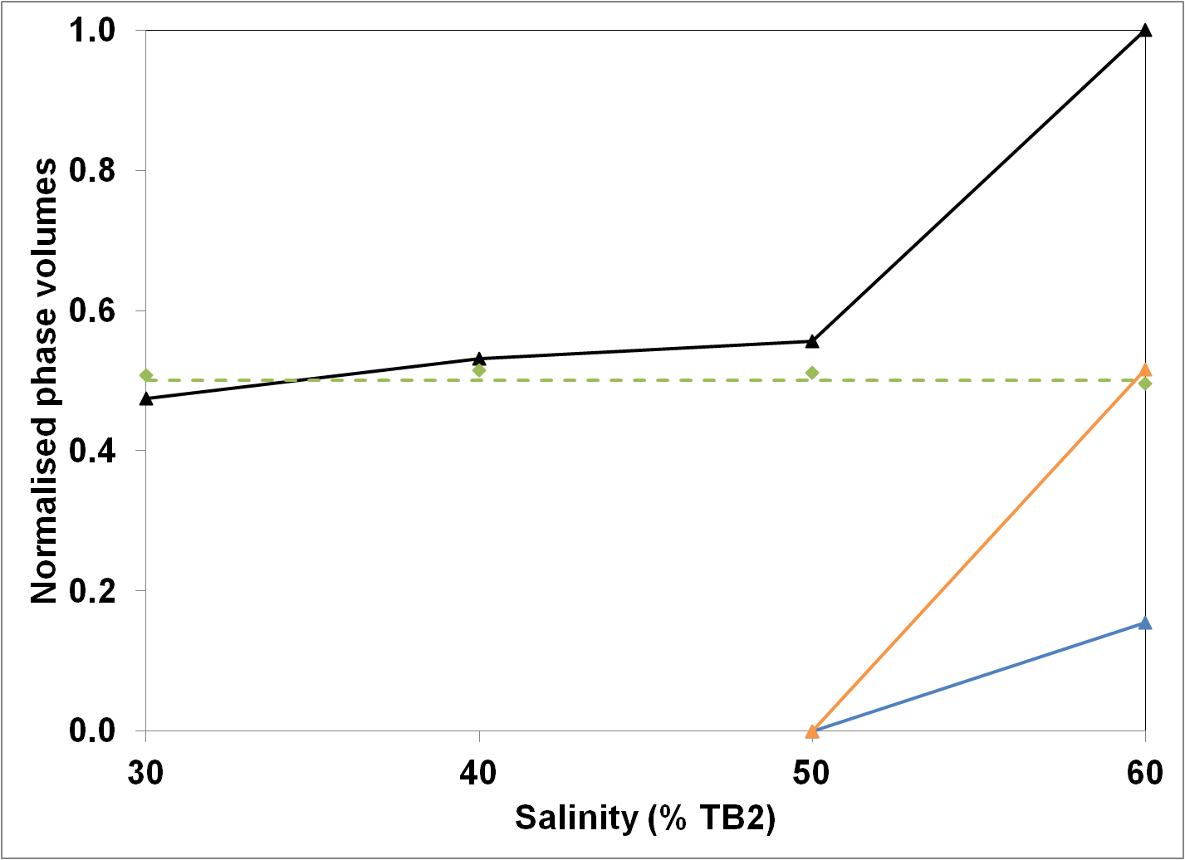
Results – Ethane @ 95psi
Salinity (% TB2)
30% 40% 50% 60%
OIL
Optimal
Initial w/o interface
MACRO
MICRO EMULSION
WATER
Type I
Type I
??
Type II

Slide 10
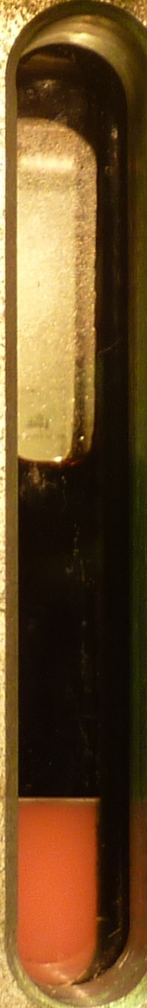
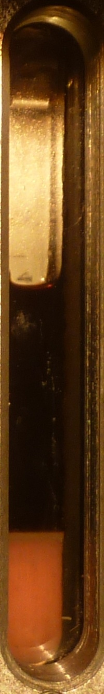
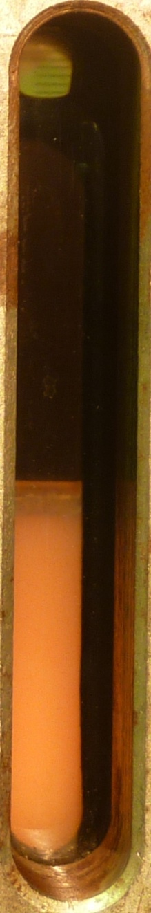
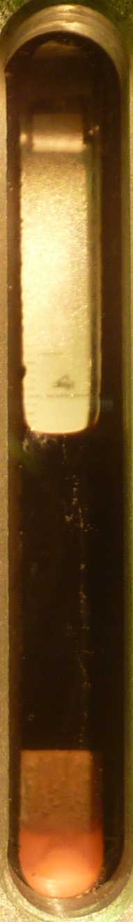
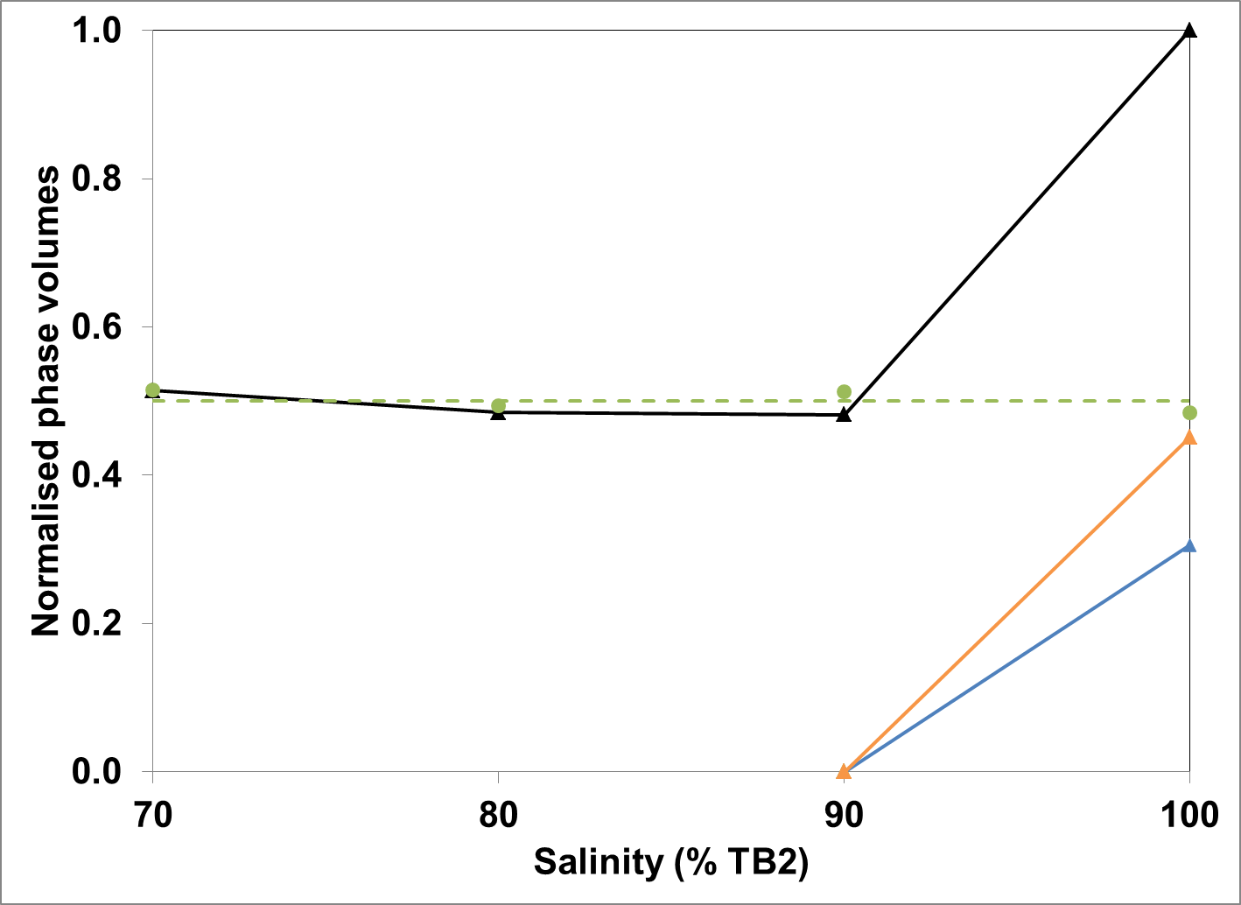
Results – CO₂ @ 60psi
Salinity (% TB2)
70% 80% 90% 100%
OIL
Optimal
Initial w/o interface
MACRO
MICRO EMULSION
WATER
Type I
Type I
Type I
Type II

Slide 11
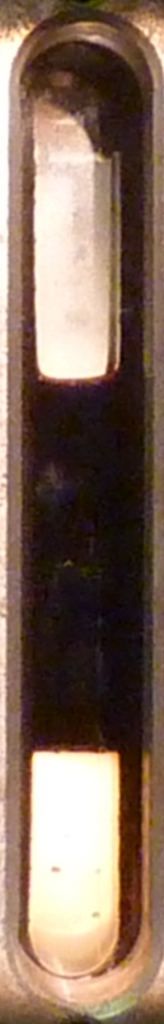
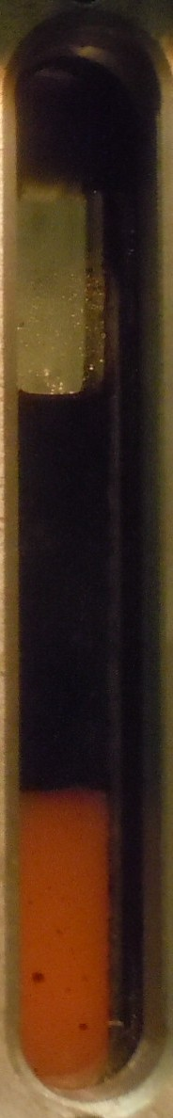
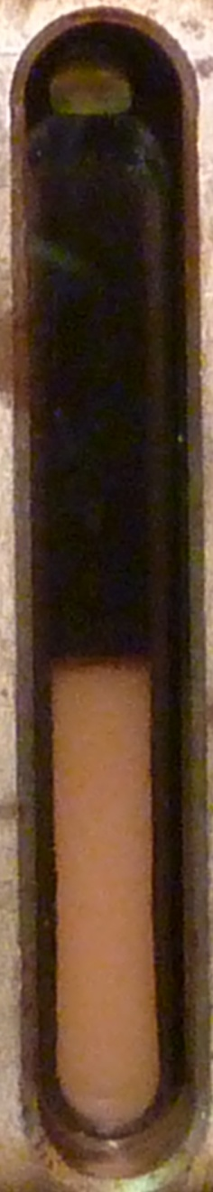
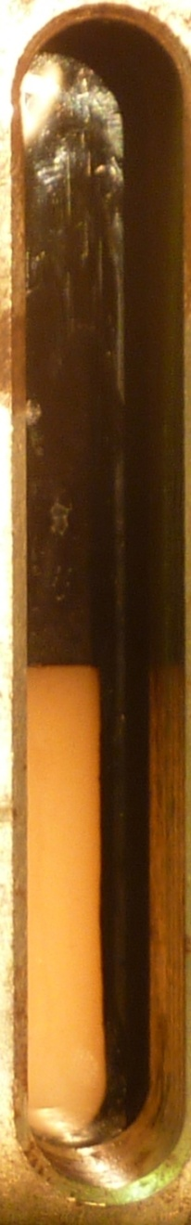
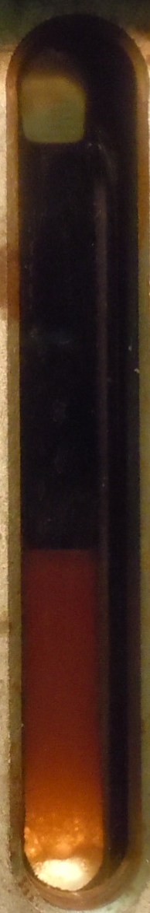
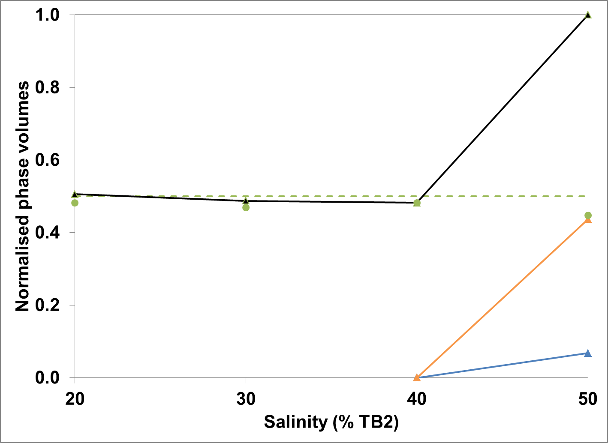
Results –CO₂ @ 600psi
Salinity (% TB2)
10% 20% 30% 40% 50%
OIL
Optimal
Initial w/o interface
MICRO EMULSION
MACRO
WATER
Type I
Type I
Type I
Type II
Type II

Slide 12
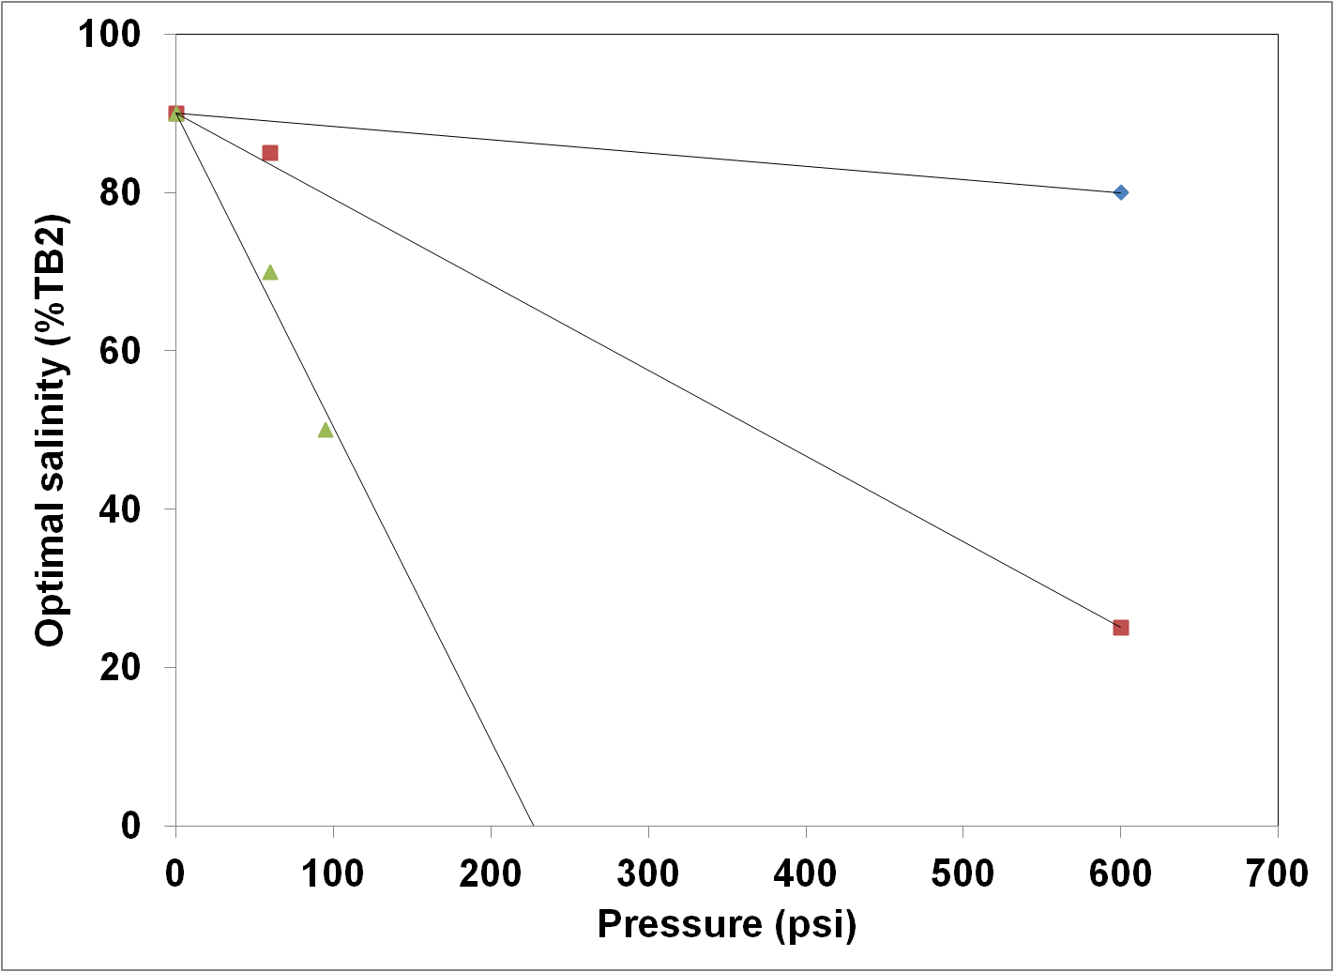
Consolidated results
Methane
CO₂
Ethane

Slide 13
Conclusions
The effect of dissolved gas (upto 600psi) on surfactant optimal salinity (C_{Ø}) has been demonstrated
  Methane
    Slight decrease in optimal salinity
  Carbon dioxide
    Decrease in the optimal salinity
  Ethane
    Substantial decrease in optimal salinity

Slide 14
QUESTIONS

Slide 15
P

